Slide 1
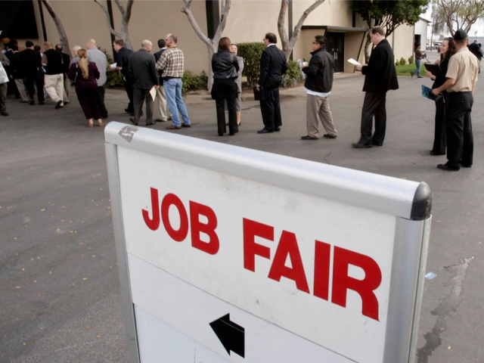
How to work a Job Fair

Slide 2
Different Types of Job Fairs
Campus-Sponsored Job Fairs
Commercial Specialty Job Fairs
Community Job Fairs

Slide 3
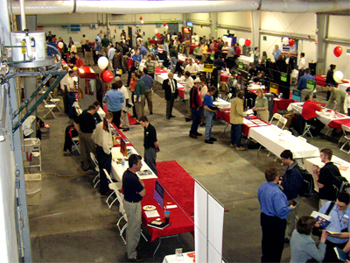
Community Job Fairs
“Free-for-all” fair offering everything
Make sure you are targeted and very direct about the type of jobs you are seeking
Identify employers you want to work for
Target their booth before entering the crowd of people

Slide 4
Tips for Job Seekers
Attending a job fair is a great way to get exposure to multiple employers
It is a great way to develop your network
It is an opportunity to find valuable information about various industries, corporations and different job positions
Employers participate to meet job seekers and recruit employees
They can provide general information about career options
They can provide specific information about current openings within their company

Slide 5
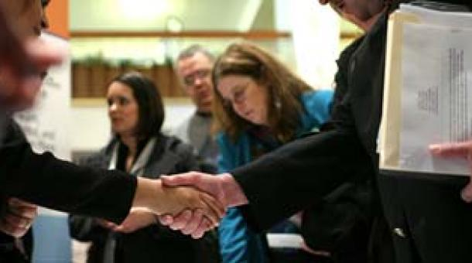
Tips for Job Seekers (cont.)
Before you leave try to make one more contact with the employer (if time permits)
Thank them for their time and reiterate your interest in their company
“I would appreciate the opportunity to speak with you further…”

Slide 6
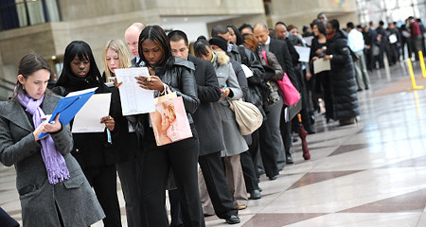
WHAT TO DO
Find out what employers will be attending the fair (www.panhandlejobfair.com)
Determine which ones interest you
Determine their location before joining the crowd
Broaden your focus and include many types of employers
You might not have considered working for a hospital but many hospitals recruit and hire professionals in different fields such as management and information systems

Slide 7
WHAT TO DO
Be organized
Bring plenty of copies of your resume
In a folder or portfolio so you appear professionally organized
Have a pen/pencil and paper to take notes
Introduce yourself (elevator speech)
This is a brief introduction telling the employer the type of position and career path you wish to follow
Be aware of time demands
Do not monopolize an employer’s time

Slide 8
WHAT TO DO
Ask specific questions about the organization and career opportunities
Offer to follow up after the fair
Ask for a business card
SMILE & BE ENTHUSIASTIC

Slide 9
What to Learn From Employers
Employment and/or hiring trends
Skills necessary for different careers or jobs
Current and/or future openings
Salary, benefits, training and other information about the organization
Who to contact for follow-up discussions

Slide 10
What Employers May Want to Learn About You
Specific career objectives
Individual strengths and weaknesses
Contributions you will make to the organization
When you are available to start

Slide 11
A Typical Question
“What are you looking for here at the job fair?”
“A job” is not an acceptable answer
Be ready with a clear and succinct description of exactly what you are seeking
After you’ve explained yourself feel comfortable asking the employer what type of candidates they are seeking

Slide 12
Tips for Success
NETWORK
Relatives, friends, co-workers
Target your resume
Ensure it’s easy to read
Are your most important credentials at the top of the resume?
Create a contact database
Listing of all employers you contact
Practice talking about yourself
Be comfortable addressing your accomplishments

Slide 13
Tips for Success (cont.)
Practice interviewing skills
Follow-up on leads
Stay confident
Job hunting takes time and energy
Stay focused on your goal
Make finding a job your primary job and attend to it daily

Slide 14
Your OWN business cards !
Contact Information
Name
Address
Phone
E-mail address
What kind of job you are looking for
Brief summary of your qualifications

Slide 15
Dressing for Success
Is dress important?
Think about classic business attire
Remain conservative so the focus is on you and not your clothes

Slide 16
?

Slide 19
The Elevator Pitch

Slide 20
The Elevator Pitch
The 30 Second Commercial or “Elevator Pitch” is a short, concise prepared speech used to introduce yourself to a potential employer, business partner, mentor, friend, golf partner,
fishing buddy….

Slide 21
The Elevator Pitch
Lasts for about 30 seconds to 1 minute
Tells who you are professionally.
Consists of your relevant experience and education
Is so captivating that the employer wants to spend more time talking with you

Slide 22
The Elevator Pitch
Parts of the Elevator Pitch
Greeting
Work Experience
Areas of Expertise
Goal

Slide 23
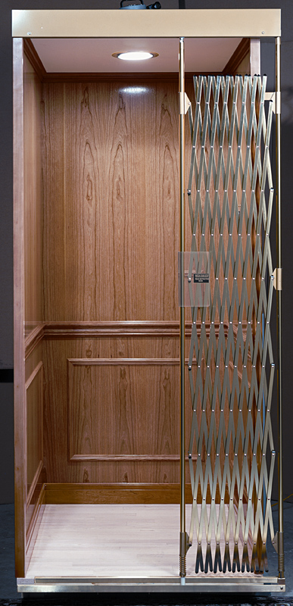
The Elevator Pitch
The Elevator Pitch usually includes:
Greeting . . . . . . . . .
include your first and last name
Experience . . . . . . .
in your job or industry
Expertise . . . . . . . .
major skills sets
Goal . . . . . . . . . . . . .
what you want to do with your experience

Slide 24
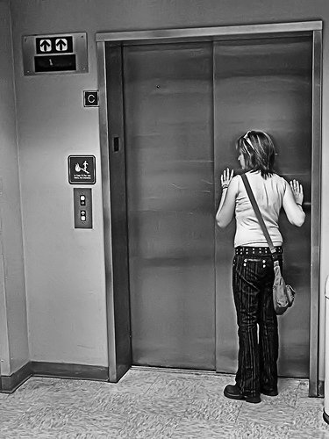
The Elevator Pitch
Greeting Hello my name is _____________
Experience I’m an experienced ____________
or
Expertise I have __ years experience in the _________ industry with expertise in ____________and___________
Strengths My strengths are_____________________ and________________
Accomplishments I have been recognized for ______________________
Professional Style I’m __________________ and ___________________
Goal I am Interested in_________________________

Slide 25
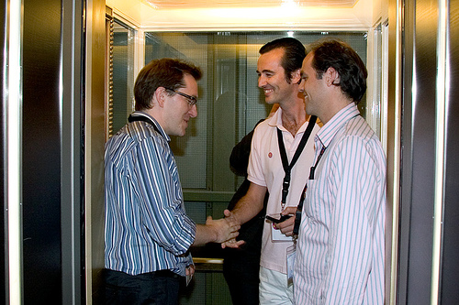
And now for an Activity…

Slide 26
Networking Tips
Up the volume, but don’t yell when speaking in a noisy environment where many conversations are going on
When speaking with someone, point your feet toward that person and note where their feet point

Slide 27
Networking: The Don’ts
Don’t lecture people or tell them how to run their business
Don’t monopolize the conversation, especially with self-congratulatory stories of your many accomplishments
Don’t speak only to people you already know at the event

Slide 28
The Final Step
Follow-up is the most important thing you can do
Take those business cards and call the employer
Review your qualifications with the employer
Ask for feedback
Hard to do but important if you want to make head way with an employer

Slide 29
After the Job Fair
Utilize the business card
If the back is empty, write down where you met them
key points you talked about
Send a thank you note – even if it’s electronic
Review points brought up
Add ideas you forgot to mention

