Slide 1



Slide 2
Who We Are
  Information, Advocacy, Education, Healthcare
What We Offer
  County Veteran Service Offices
  State Veterans’ Homes Program
  Free Benefits & Disability Claims Counseling
  State Women Veterans’ Coordinator
  Florida Veterans’ Benefits Guide
Where to Find Us:
  Website: www.FloridaVets.org
  Facebook: www.facebook.com/floridaveterans
  LinkedIn: www.linkedin.com/company/fdva
  FDVA Mobile App
Supporting Organizations:
  Veterans Florida (Florida Is for Veterans, Inc.)
  Florida Veterans Foundation

Slide 3


Our Values
  Collaboration
  Openness and Transparency
  Resource Optimization
  Organizational Efficiency
  Effective Leadership
  Responsible Financial Stewardship

Slide 4

Who We Are
  Direct Support Organization
  of Florida Department of Veterans’ Affairs (FDVA)
  501(c)(3) Nonprofit
Important Veteran Needs
  Suicide Prevention
  Crisis Center Support
  Mental Healthcare
  Aging Veterans Support
  Benefits Education
  Transportation
  Wellness

Slide 5

Serving All Florida Veterans
  Represents Nearly 1.6 million Florida and Families
    All Service Branches
    All Service Eras
      World War II
      Korea
      Vietnam
      Cold War
      Global War on Terror
  FVF Aids “All Veteran, All Era’s”
    30% Rural

Slide 6

Serving All Florida Veterans
  95% donations to Florida Veterans
  Reach 28,000 Florida Veterans Every Month
  Represents Veterans through the Florida Veteran’s Council
    Florida Veterans Service Organizations (VSO’s)
      67 Counties
      135 County Veterans Service Officers
  Advocates via Legislative Action
  Provides Education and Relief Resources to Florida Veterans

Slide 7
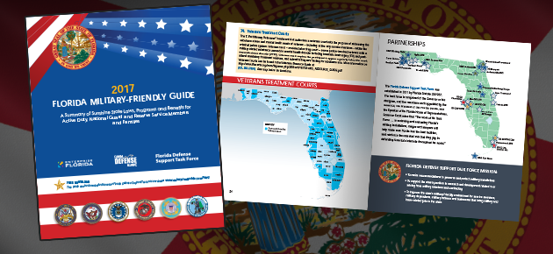
Making A Difference in the Lives of Veterans
  $1.25 million grant
    $800,000 to 900+ Veterans for Emergency Financial Assistance
    5% Administration
    Disaster Relief
    Mental Health/PTSD
    Homeless Veteran
    Stand Downs
    Veterans Hall of Fame

Slide 8
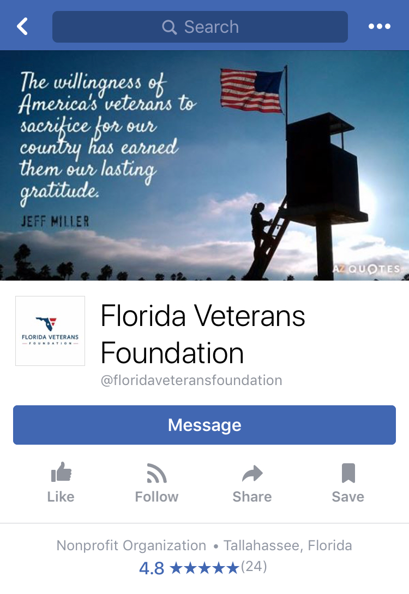
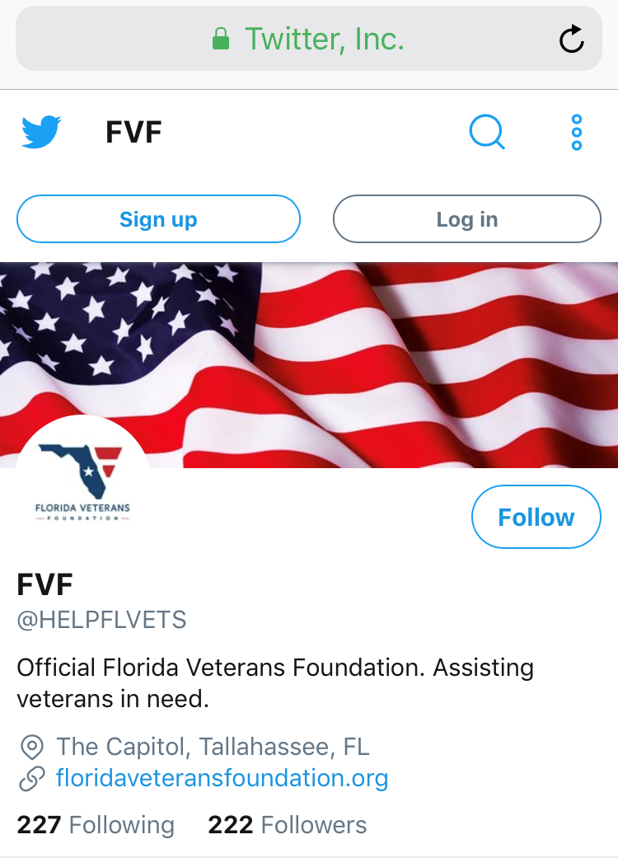
  5 Star Vet Center Mental Health Grant Match
  NE FL Women Veterans
  Veteran Needs Assessment
  Funeral Homes
  Aging Veterans Relief
  Assisted DAV Transport
    7,701 Veterans
    192,814 Miles

Slide 9
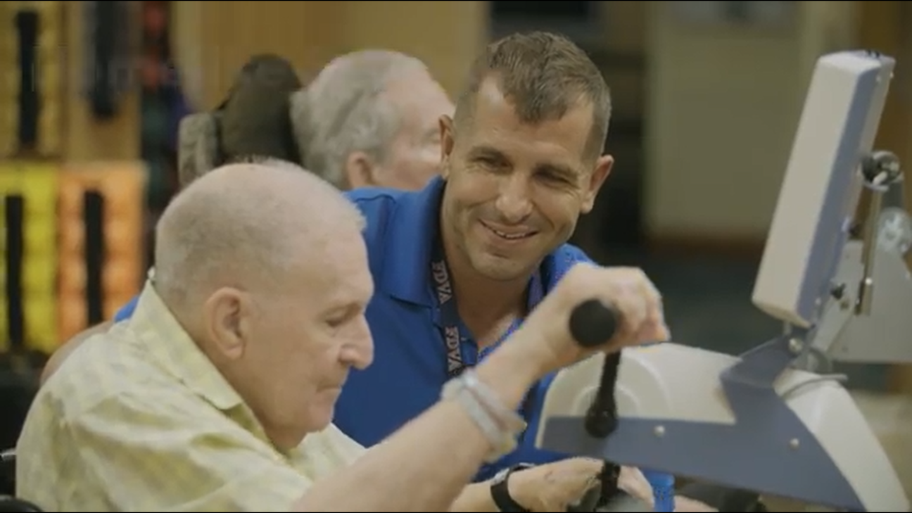
Current Initiatives
  Educate 3,100 FL ALF Administrators in Veteran Benefits
  Teaming with In home Health Care to keep Veterans at home
    Potential $1 Bil in Benefits
  Suicide Prevention / Crisis Centers / Managing Entities / Mental Health /Opioid Addiction

Slide 10
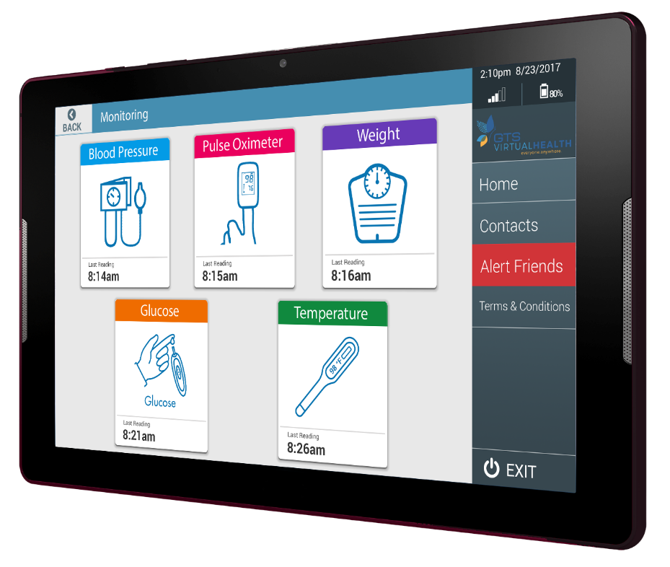
Current Initiatives
  Proactively Engages Military pre/post-AD
    Community Building among Veterans & VSO’s
  2019 Legislative Ask
  Statewide VTC Committee
  Registering Veterans
  Telehealth
    Reduced Medical Visits by 80%

Slide 11
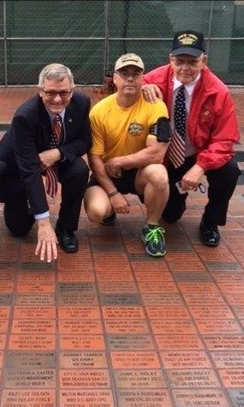
  Veterans Memorial
  Educational Videos for Assisted Living Facilities
  Florida HR Conference
  Sponsors
  Grant Watch
  Donation
  Social Media Presence
  VA Work-Study and AARP Hires

Slide 12
The Capitol – Suite 2107
400 South Monroe Street
Tallahassee, Florida 32399-0001
(850) 488-4181
FVF@fdva.state.fl.us
www.floridaveteransfoundation.org
www.facebook.com/floridaveteransfoundation
www.twitter.com/HELPFLVETS

